Slide 1
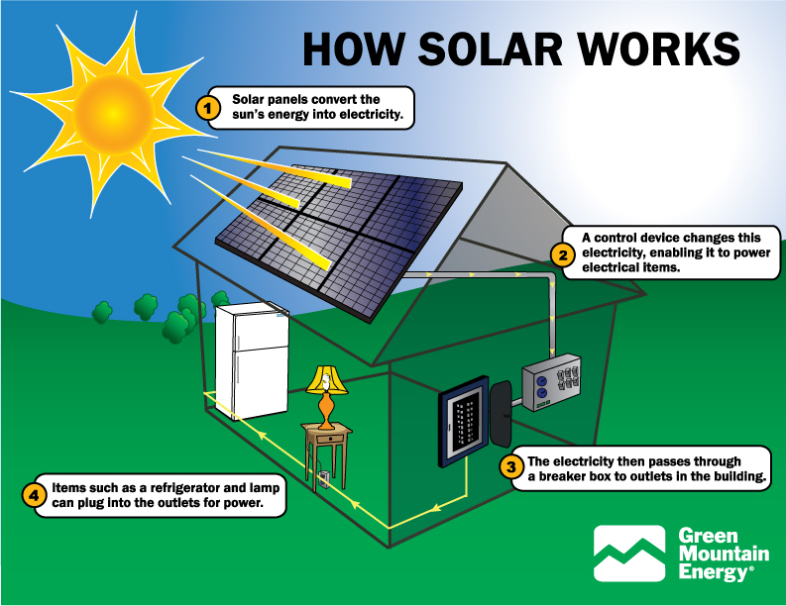
How Solar Panels Are Changing the World
An introduction to solar energy and its impact.
20 sec

Slide 2
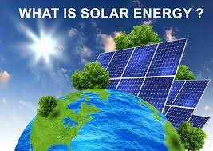
What is Solar Energy?
Solar energy is the power we get from the sun.
20 sec

Slide 3
What Are Solar Panels?
Solar panels are devices that turn sunlight into electricity.
20 sec

Slide 4
How Do Solar Panels Work?
They use photovoltaic cells to convert sunlight into electric power.
20 sec

Slide 5
Where Are Solar Panels Used?
They are used in homes, schools, businesses, and solar farms.
20 sec

Slide 6
Solar Panels in Homes
Many people install solar panels on their rooftops to save energy.
20 sec

Slide 7
Solar Panels in Schools
Some schools use solar panels to reduce electricity costs.
20 sec

Slide 8
Solar Panels in Businesses
Companies use solar panels to lower their energy bills.
20 sec

Slide 9
Solar Farms
Large areas with many solar panels produce electricity for entire communities.
20 sec

Slide 10
Benefits: Clean Energy
Solar energy does not pollute the air. It is a clean resource.
20 sec

Slide 11
Benefits: Lower Bills
Using solar power reduces electricity bills over time.
20 sec

Slide 12
Benefits: Energy Independence
With solar panels, people can generate their own electricity.
20 sec

Slide 13
Environmental Impact
Solar energy helps reduce CO₂ emissions and combat climate change.
20 sec

Slide 14
Challenges: Installation Cost
The initial cost of solar panels is still high for some people.
20 sec

Slide 15
Challenges: Weather
Solar energy production depends on sunlight, so it works best on sunny days.
20 sec

Slide 16
Innovations: Portable Solar
Portable solar panels can be used in remote areas or for camping.
20 sec

Slide 17
Innovations: Solar Cars
Some vehicles now use solar energy to reduce fuel consumption.
20 sec

Slide 18
Leading Countries
Germany, China, and the USA are leaders in solar power use.
20 sec

Slide 19
Future of Solar Energy
Solar energy is becoming cheaper and more efficient every year.
20 sec

Slide 20
Call to Action
We should all consider using solar energy to protect our planet.
20 sec

